Slide 1
Red Black Trees

Slide 2
Introduction
A red-black tree is a kind of self-balancing binary search tree with one extra bit of storage per node: its color, which can be either RED or BLACK.
By constraining the node colors on any simple path from the root to a leaf, red-black trees ensure that no such path is more than twice as long as any other, so that the tree is approximately balanced.
Although the balance of the tree is not perfect, it is good enough to reduce the searching time and maintain it around O(log n) time, where n is the total number of elements in the tree.
Each node of the tree contains the attributes color, key, left, right and parent.

Slide 3
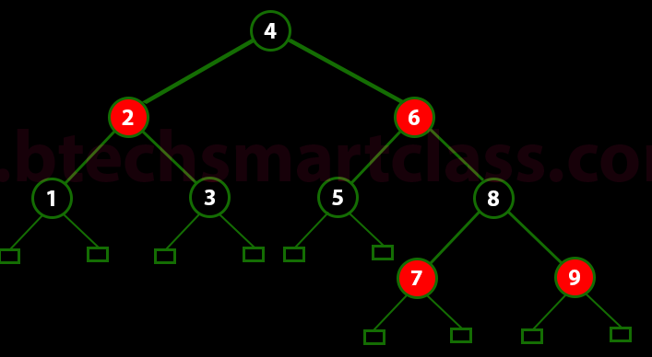
Red-Black Properties
Property #1: Red - Black Tree must be a Binary Search Tree.
Property #2: The ROOT node must be colored BLACK.
Property #3: The children of Red colored node must be colored BLACK. (There should not be two consecutive RED nodes).
Property #4: In all the paths of the tree, there should be same number of BLACK colored nodes.
Property #5: Every new node must be inserted with RED color.
Property #6: Every leaf (i.e. NULL node) must be colored BLACK.

Slide 4
Why Red-Black Trees?
Most of the BST operations (e.g., search, max, min, insert, delete.. etc) take O(h) time where h is the height of the BST.
The cost of these operations may become O(n) for a skewed Binary tree.
If we make sure that the height of the tree remains O(log n) after every insertion and deletion, then we can guarantee an upper bound of O(log n) for all these operations.
The height of a Red-Black tree is always O(log n) where n is the number of nodes in the tree.
Sr. No. | Algorithm | Time Complexity
1. | Search | O(log n)
2. | Insert | O(log n)
3. | Delete | O(log n)
Sr. No | Algorithm | TC
1. | Search | O(log n)
2. | Insert | O(log n)
3. | Delete | O(log n)
“n” is the total number of elements in the red-black tree.

Slide 5
Comparison with AVL Trees
The AVL trees are more balanced compared to Red-Black Trees, but they may cause more rotations during insertion and deletion.
So if your application involves frequent insertions and deletions, then Red-Black trees should be preferred.
And if the insertions and deletions are less frequent and search is a more frequent operation, then AVL tree should be preferred over Red-Black Tree.

Slide 6
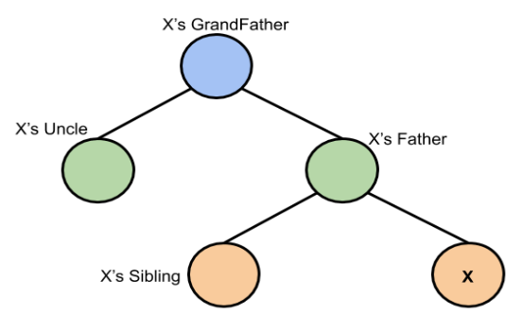
Red-Black Tree : Insertion
In AVL tree insertion, we used rotation as a tool to do balancing after insertion. In the Red-Black tree, we use two tools to do the balancing. 1. Recoloring 2. Rotation
Insertion Properties:
1. Create Black root node if the tree is empty
2. Insert new node as Red.
2.1) If parent is Black then Ok.
2.2) If parent is Red then
a. If uncle is Red , then recolor
b. If Uncle is Black or absent then rotate and recolor.
Representation we will be using:

Slide 7
Red-Black Tree : Insertion
The insertion operation in Red Black tree is performed using the following steps...
Step 1 - Check whether tree is Empty.
Step 2 - If tree is Empty then insert the newNode as Root node with color Black and exit from the operation.
Step 3 - If tree is not Empty then insert the newNode as leaf node with color Red.
Step 4 - If the parent of newNode is Black then exit from the operation.
Step 5 - If the parent of newNode is Red then check the color of parentnode's sibling of newNode.
Step 6 - If it is colored Black or NULL then make suitable Rotation and Recolor it.
Step 7 - If it is colored Red then perform Recolor. Repeat the same until tree becomes Red Black Tree.
Representation we will be using:

Slide 8
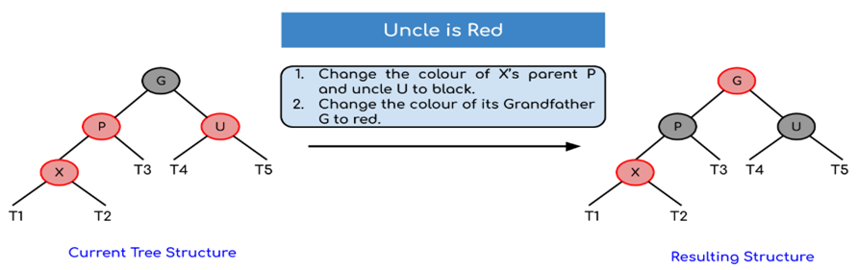
Insertion Logic: Case 2.2 a : If parent is Red then if uncle is Red , then recolor ( change color of parent and uncle. Also change color of grandfather if grandfather is not a root node.)

Slide 9
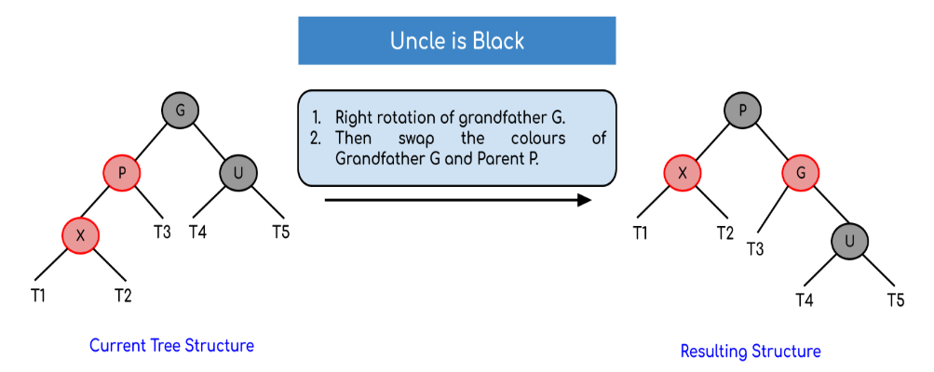
Insertion Logic: If parent is Red then If uncle is Black or absent , then rotate and recolor
Case 1: Left Left Case (LL rotation)

Slide 10
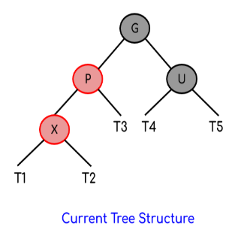
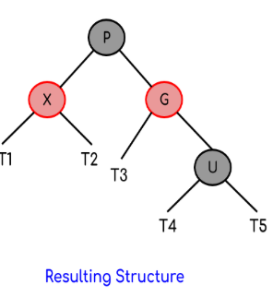
Insertion Logic: If parent is Red then If uncle is Black or absent , then rotate and recolor
Case 1: Left Left Case (LL rotation)
LL rotation of grandparent
Recolor (change color of G and P(i.e G->lchild )

Slide 11
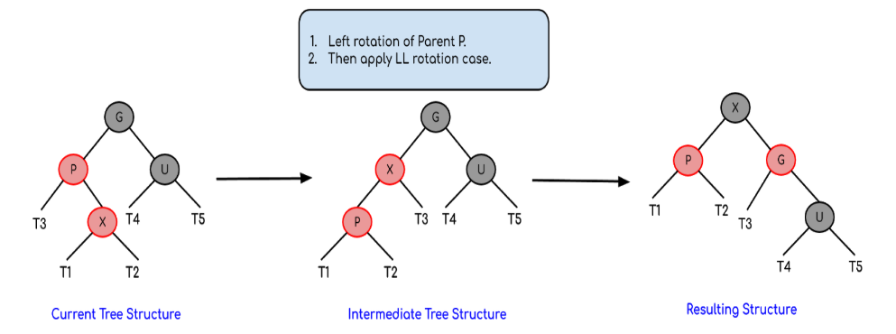
Insertion Logic: If parent is Red then If uncle is Black or absent , then rotate and recolor
Case 2: Left Right Case (LR rotation)

Slide 12
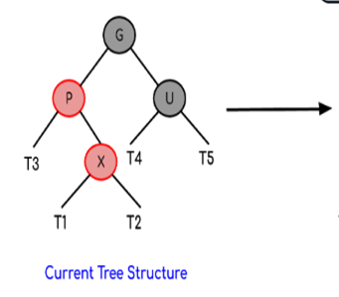
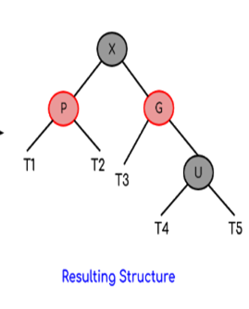
Insertion Logic: If parent is Red then If uncle is Black or absent , then rotate and recolor
Case 2: Left Right Case (LR rotation)
LR rotation of grandparent
Recolor (change color of G and X (i.e. G->lchild->rchild )

Slide 13
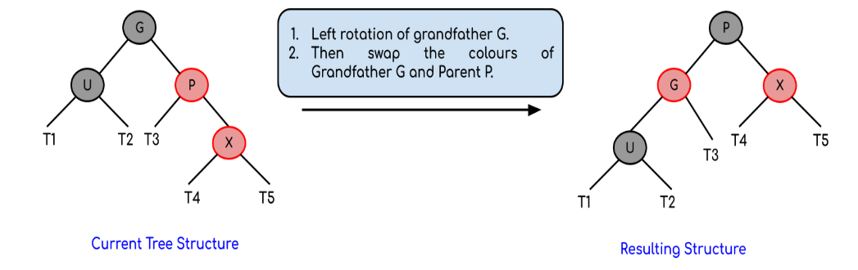
Insertion Logic: If parent is Red then If uncle is Black or absent , then rotate and recolor
But, if the node’s uncle has black colour then there are 4 possible cases:
Case 3: Right Right Case (RR rotation)

Slide 14
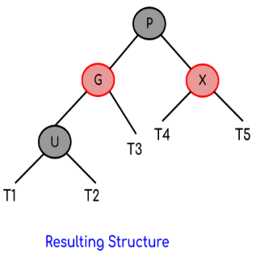
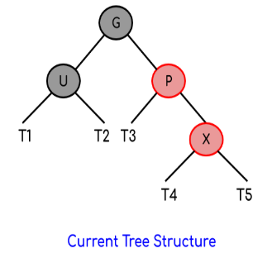
Insertion Logic: If parent is Red then If uncle is Black or absent , then rotate and recolor
But, if the node’s uncle has black colour then there are 4 possible cases:
Case 3: Right Right Case (RR rotation)
RR rotation of grandparent
Recolor (change color of G and P(i.e G->rchil)d )

Slide 15
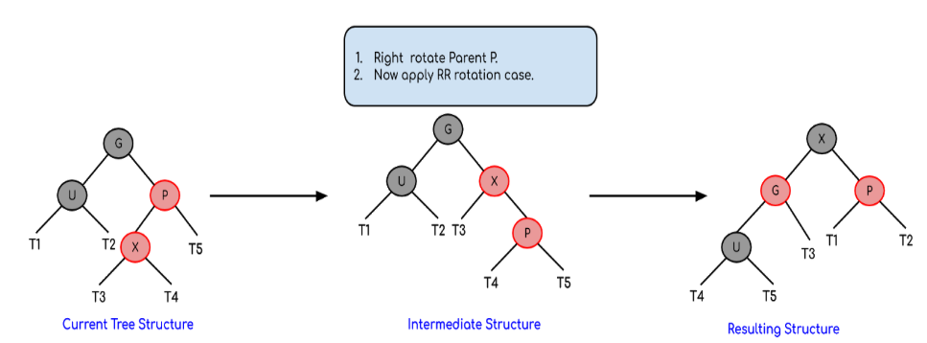
Insertion Logic: If parent is Red then If uncle is Black or absent , then rotate and recolor
But, if the node’s uncle has black colour then there are 4 possible cases:
Case 4: Right Left Case (RL rotation)

Slide 16
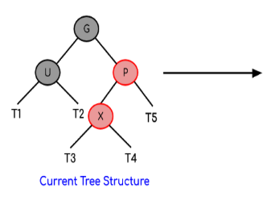
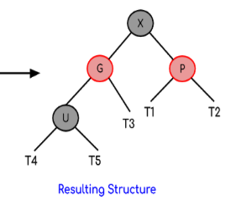

Insertion Logic: If parent is Red then If uncle is Black or absent , then rotate and recolor
But, if the node’s uncle has black colour then there are 4 possible cases:
Case 4: Right Left Case (RL rotation)
RL rotation of grandparent
Recolor (change color of G and X (i.e.G->rchild->lchild)

Slide 17
Example: 3,2,5,6,10,4,8,9
Insertion Properties:
1. Create Black root node if the tree is empty
2. Insert new node as Red.
2.1) If parent is Black then Ok.
2.2) If parent is Red then
a. If uncle is Red , then recolor
b. If Uncle is Black or absent then rotate and recolor.

Slide 18

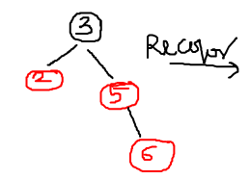
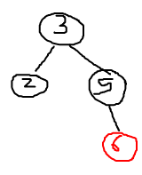
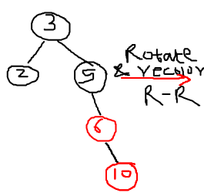
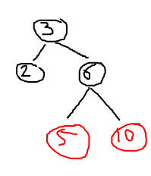
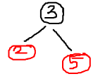
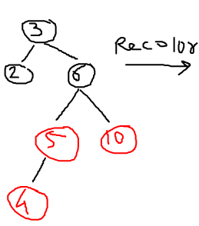
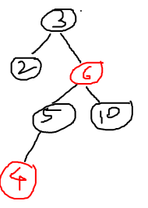
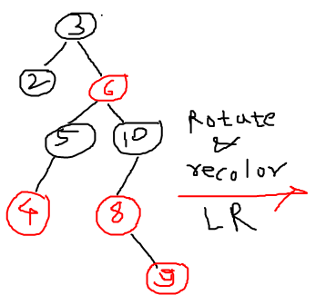
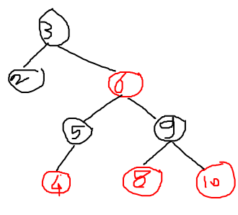

Slide 19
Example: 3,2,5,6,10,4,8,9

Slide 20

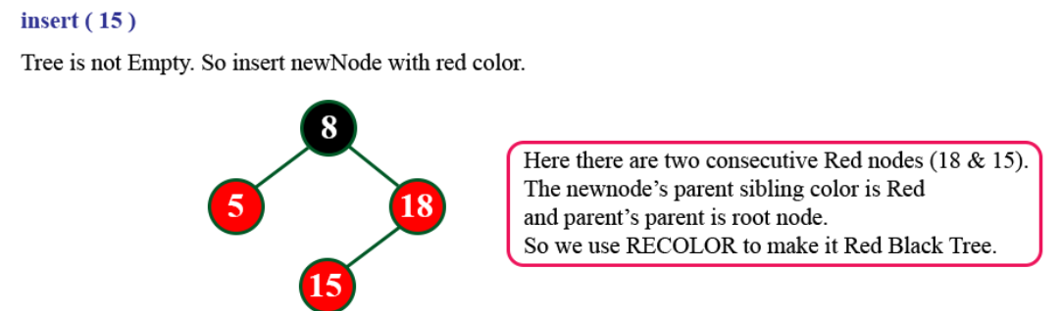
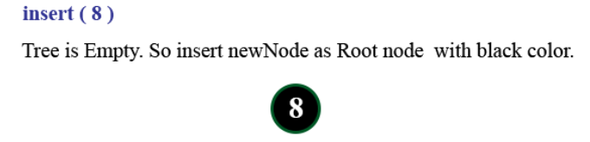
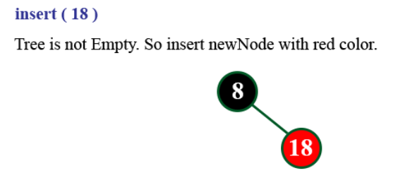
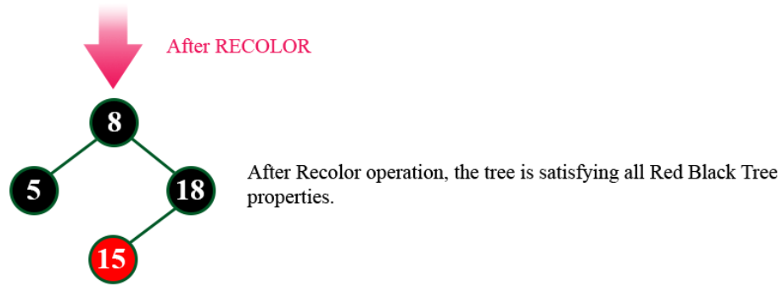
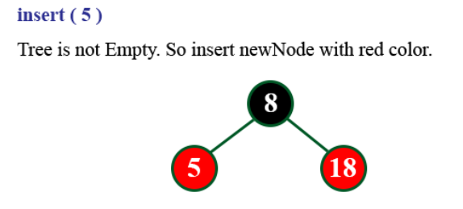

Slide 21
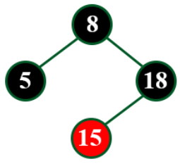
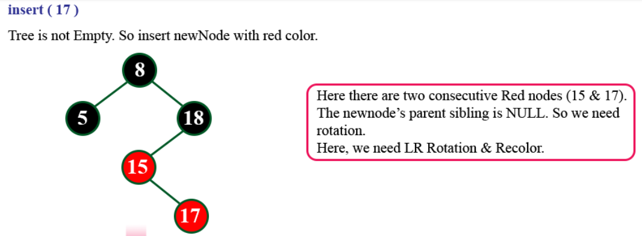
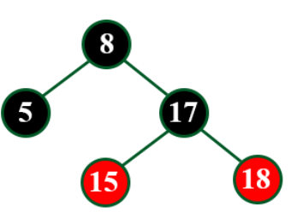
After LR rotation and recoloring

Slide 22
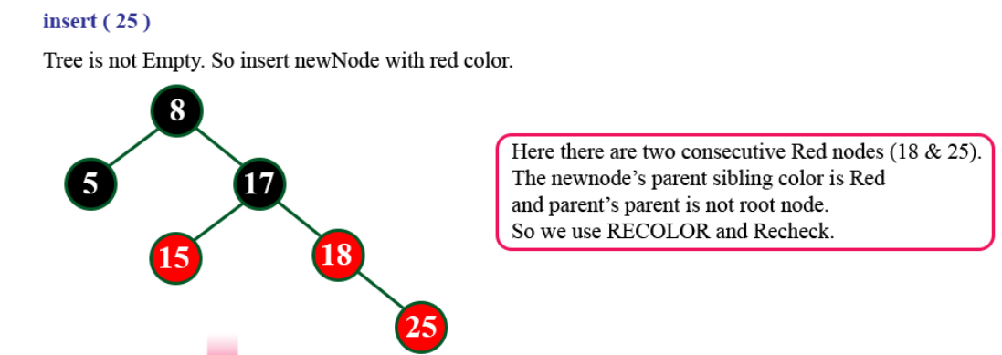

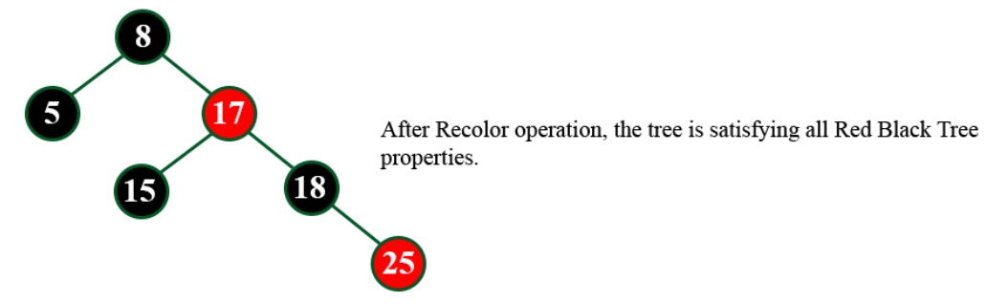

Slide 23
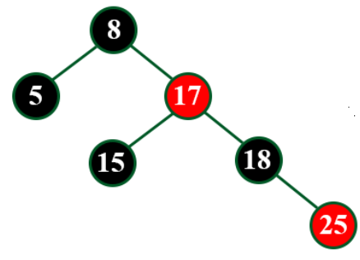
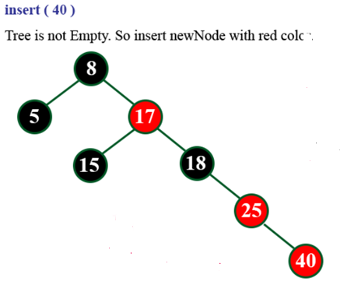
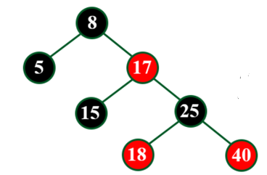
After RR rotation and recoloring

Slide 24
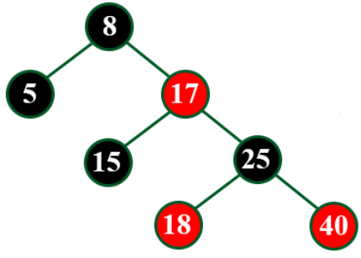
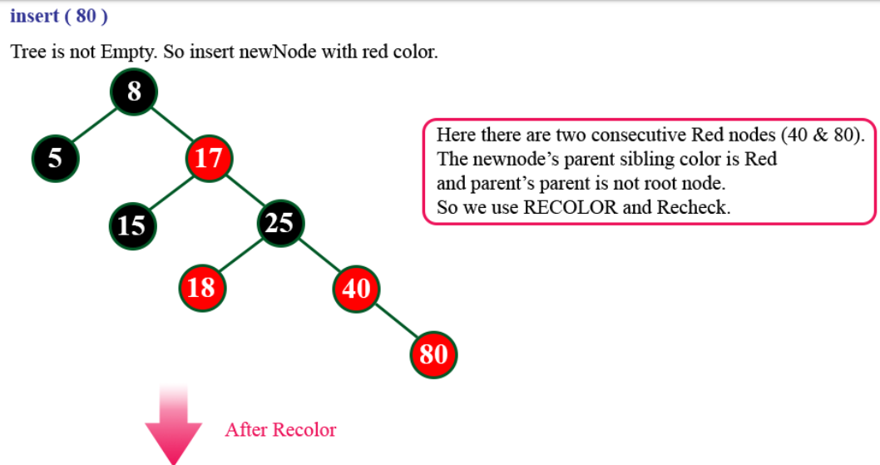
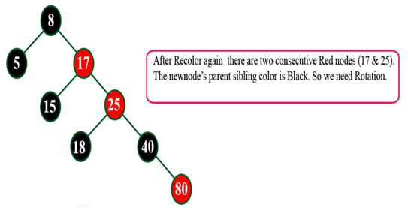
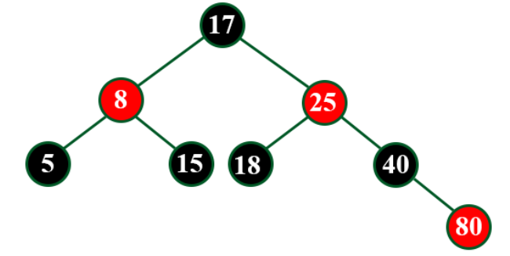
After RR rotation and recolor

Slide 25
Black Height
The number of black nodes on any simple path from, but not including, a node x down to a leaf is called the black-height of the node, denoted bh(x).
All descending simple paths from the node have the same number of black nodes.
Black-height of a red-black tree is the black-height of its root.

Slide 26
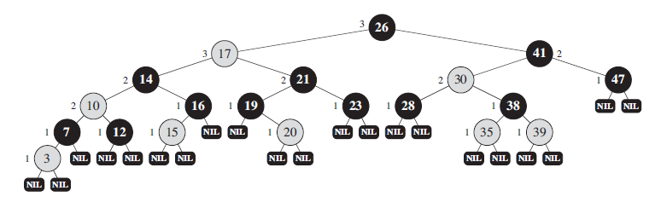
Example
Black Height:
The number of black nodes on any simple path from a node x(not including x) down to a leaf is called the black-height of the node, denoted bh(x).
All descending simple paths from the node have the same number of black nodes.
Black-height of a red-black tree is the black-height of its root.
A red-black tree with black nodes darkened and red nodes shaded. Every node in a red-black tree is either red or black, the children of a red node are both black, and every simple path from a node to a descendant leaf contains the same number of black nodes. Every leaf, shown as a NIL, is black. Each non-NIL node is marked with its black-height; NILs have black-height 0.

Slide 27
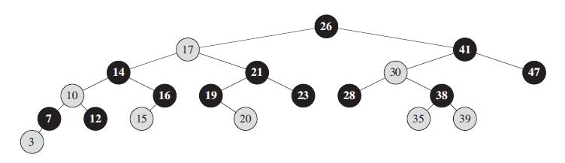
Example
The same red-black tree but with leaves omitted entirely.

Slide 28
Red Black Tree : Deletion

Slide 29
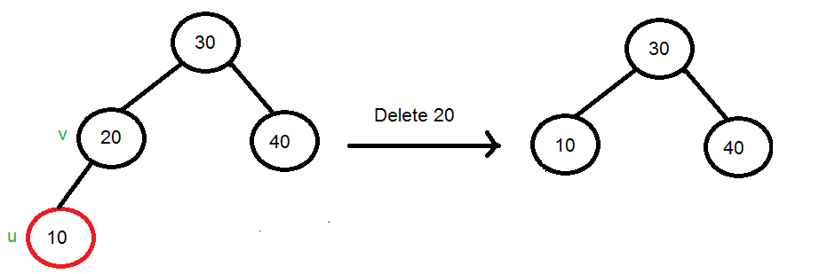
Let v be the node to be deleted and u be the child that replaces v. If node to be deleted is red delete it directly. Case 1: u is red and v is black
Here node 20 is not deleted but it is replaced by 10. Hence after replacement color of 10 is black only.
When node to be deleted is red, delete it directly.

Slide 30
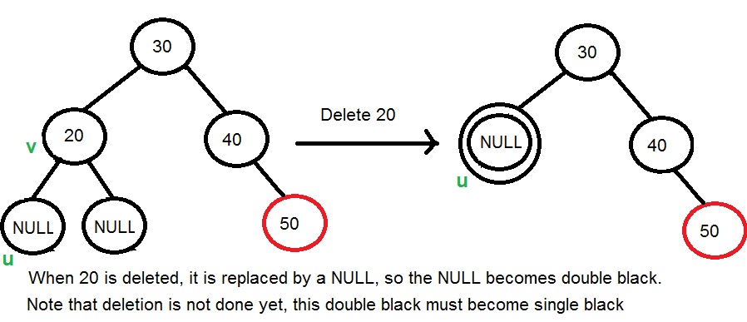
Case 2: If Both u and v are Black.
2.1) Color u as double black. Now our task reduces to convert this double black to single black. Note that If v is leaf, then u is NULL and color of NULL is considered black. So the deletion of a black leaf also causes a double black.
2.2) Do following while the current node u is double black, and it is not the root. Let sibling of node be s.
….(a): If sibling s is black and at least one of sibling’s children is red, perform rotation(s).
Let the red child of s be r. This case can be divided in four subcases depending upon positions of s and r. …………..(i) Left Left Case (s is left child of its parent and r is left child of s or both children of s are red). …………..(ii) Left Right Case (s is left child of its parent and r is right child of s). …………..(iii) Right Right Case (s is right child of its parent and r is right child of s or both children of s are red)
…………..(iv) Right Left Case (s is right child of its parent and r is left child of s)

Slide 31
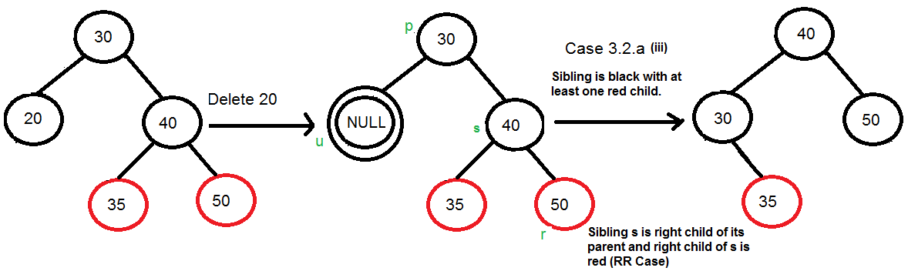
2.2 a) Do following while the current node u is double black, and it is not the root. Let sibling of node be s.
If sibling s is black and at least one of sibling’s children is red, perform rotation(s).
Let the red child of s be r. This case can be divided in four subcases depending upon positions of s and r. …………..(iii) Right Right Case (s is right child of its parent and r is right child of s or both children of s are red)

Slide 32
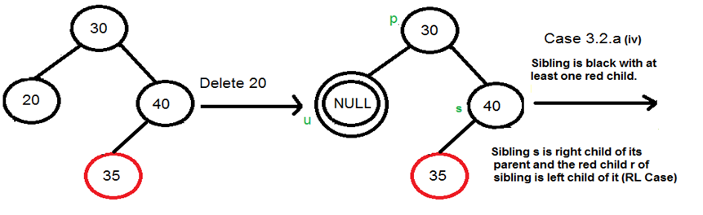
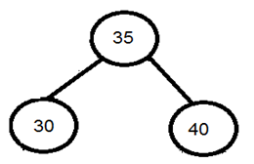
2.2a) Do following while the current node u is double black, and it is not the root. Let sibling of node be s.
If sibling s is black and at least one of sibling’s children is red, perform rotation(s).
Let the red child of s be r. This case can be divided in four subcases depending upon positions of s and r. …………..(iv) Right Left Case (s is right child of its parent and r is left child of s)

Slide 33
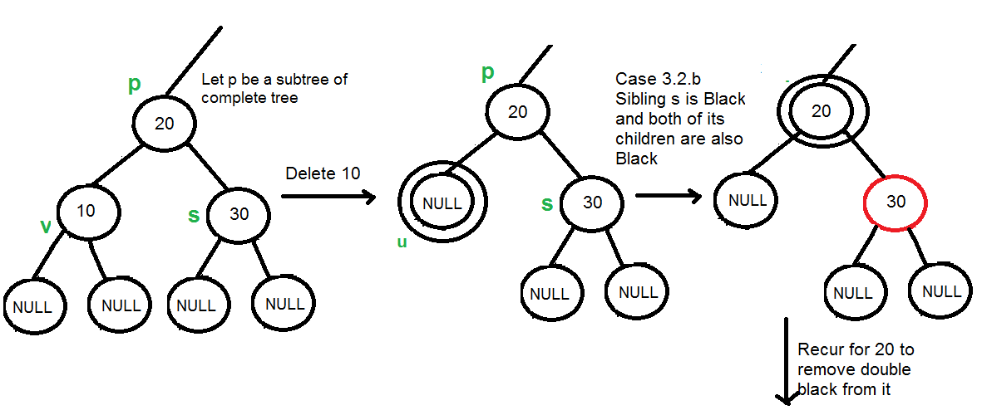
2.2 b) : If sibling is black and its both children are black,
1. Add black to parent - Here If Parent is red it becomes black and if parent is black it becomes double black
2. Make sibling Red
3. If still double black, apply the other cases.

Slide 34
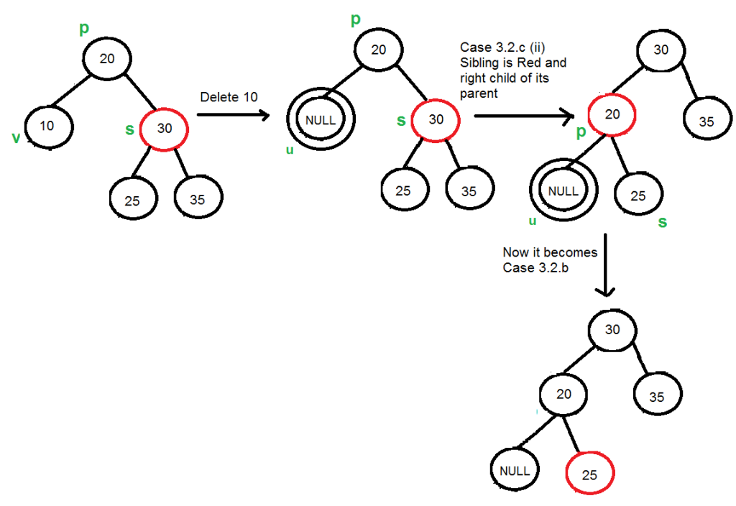
2.2 c) If sibling is red, perform a rotation to move old sibling up, recolor the old sibling and parent. The new sibling is always black (See the below diagram). This mainly converts the tree to black sibling case (by rotation) and leads to case (a) or (b).
This case can be divided in two subcases. …………..(i) Left Case (s is left child of its parent). …………..(ii) Right Case (s is right child of its parent).
New sibling
Change color of sibling and parent

Slide 35
3.3) If double black node u is root, make it single black and return

Slide 36


Watch For Red-Black Tree Deletion: 1) https://www.youtube.com/watch?v=w5cvkTXY0vQ 2) https://www.youtube.com/watch?v=CTvfzU_uNKE
After deleting 55 we get
2.2 c) If sibling is red, perform a rotation to move old sibling up, recolor the old sibling and parent. The new sibling is always black (See the below diagram). This mainly converts the tree to black sibling case (by rotation) and leads to case (a) or (b).
This case can be divided in two subcases. …………..(i) Left Case (s is left child of its parent). …………..(ii) Right Case (s is right child of its parent).
2.2 b) : If sibling is black and its both children are black,
-Add black to parent - Here If Parent is red it becomes black and if parent is black it becomes double black
-Make sibling Red
-If still double black, apply the other cases.

Slide 37






Watch For Red-Black Tree Deletion: 1) https://www.youtube.com/watch?v=w5cvkTXY0vQ 2) https://www.youtube.com/watch?v=CTvfzU_uNKE
After deleting 55 we get
After deleting 30 we get
After deleting 90 we get
After deleting 80 we get
After deleting 50 we get
After deleting 35 we get
After deleting 15 we get

Slide 38
Example: https://www.programiz.com/dsa/deletion-from-a-red-black-tree Time complexity of RB Tree Insertion and deletion is O(log n)

